Slide 1
A case of Transforming Violence in Venezuela

Slide 2
I want to start with two small exercises
The first one…
what comes to your mind when I mention the word: Alcatraz?

Slide 3
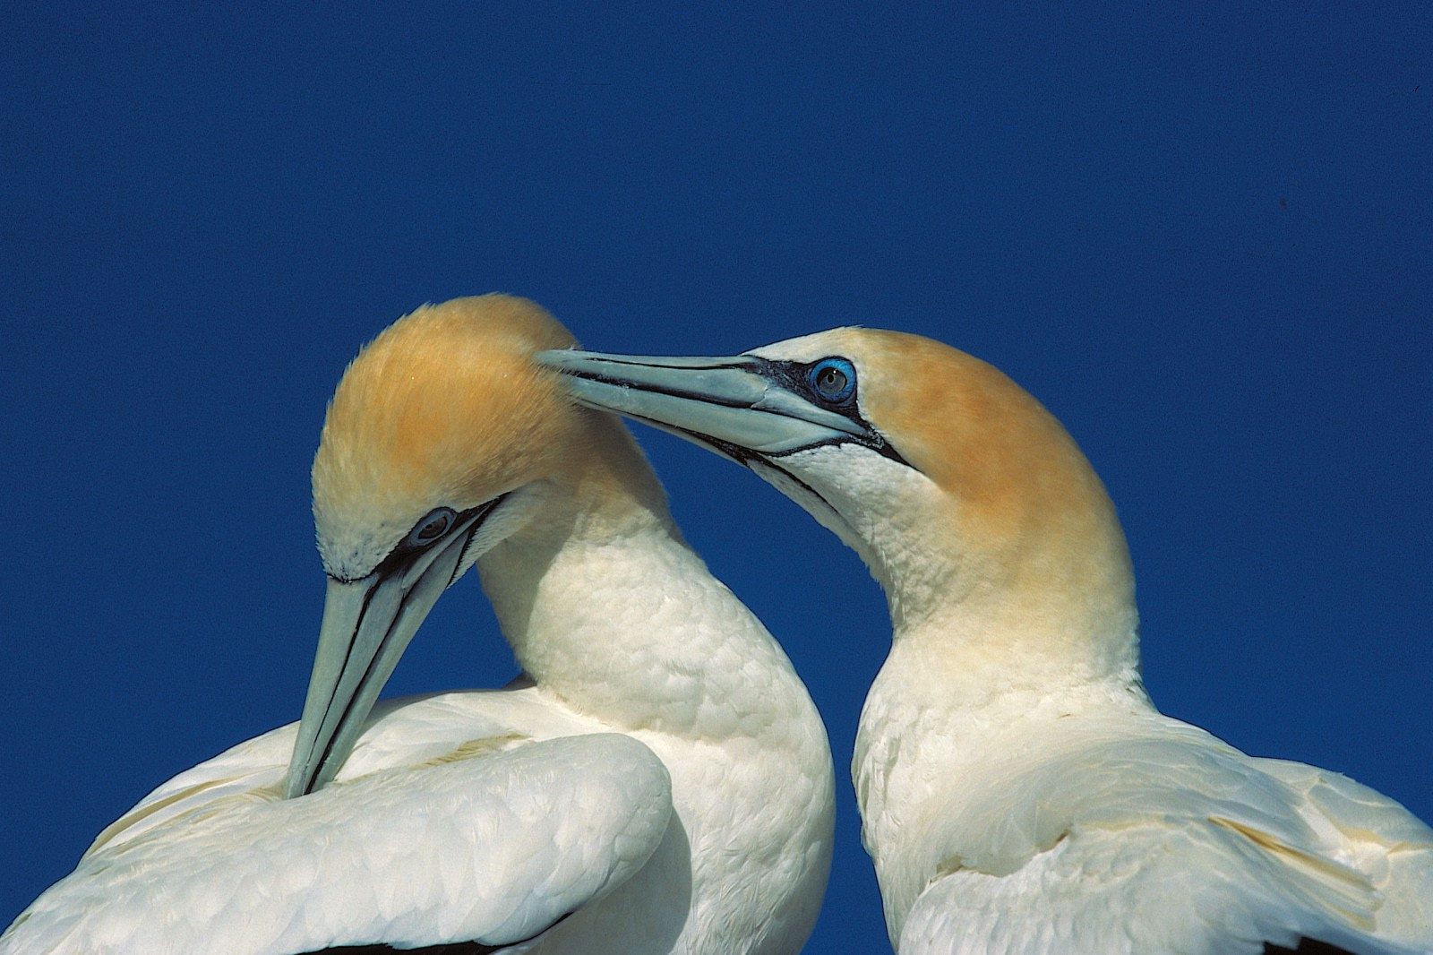
A bird?

Slide 4
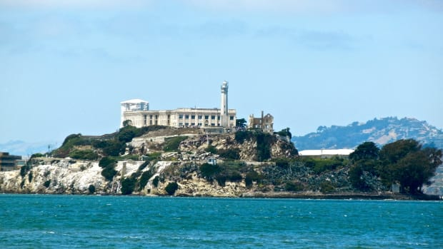
The legendary Jail?

Slide 5
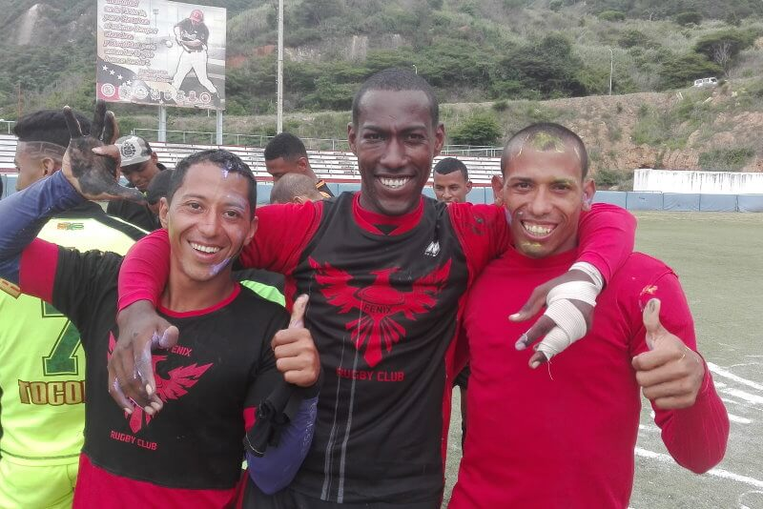
Or if you are from Venezuela, or read about it before, you may also have some rugby in mind

Slide 6
The second one…
Imagine you are born and spend your whole life growing up in a low-income area of a little town one hour away from Caracas.

Slide 7
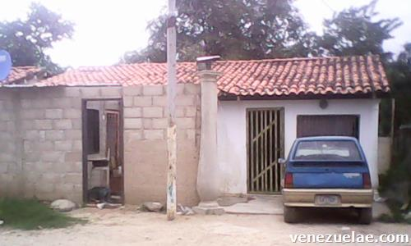
Your house could have looked like this

Slide 8
Viewer discretion, is advised

Slide 9
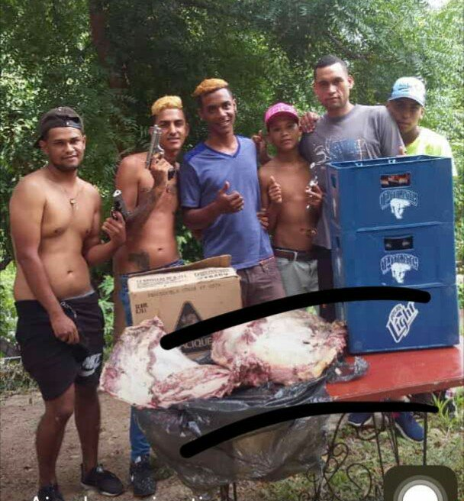
You grew up surrounded by gang violence since an early age, and hanging out with your friends looked like this

Slide 10
The picture…
There is little to no opportunity to get away from it,
You were not raised by your mom, but by other family members and always felt marginalized,
You didn’t know any other way of life.

Slide 11
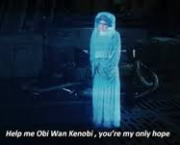
…The picture doesn’t look too good, right?
Well… for some this project is
Rugby

Slide 12
Now the last exercise
Imagine you get caught committing a crime with some members of your gang,
But instead of going straight to jail, you are presented, for the first time in your life, with the option of paying back for the damage with work…
Which one would you choose?

Slide 13
Proyecto Alcatraz
Created in 2003,
It presented an opportunity to three young men that robbed the ‘Hacienda Santa Teresa’.
It is a social reintegration program for young people and adults with criminal attitudes.

Slide 14
Proyecto Alcatraz
Throughout the project, young beneficiaries receive:
Psychological Support
Training in values and restorative justice,
Education for work,
All of this while using rugby as a vehicle of transformation, to move people from a world of darkness to one of light.

Slide 15
Proyecto Alcatraz
In this project, youth gang members participate voluntarily to take the opportunity to change their lives and transform their violent leadership into a virtuous one.
The program achieves this through three routes:
Reinsertion and Restorative Justice: Santa Teresa Foundation directly contacts and recruits gang members inviting them to go through four work phases in which, assisted by a multidisciplinary group of professionals, the participants develop new social and work skills to face a new life.
This to recover the broken relationships between victims and perpetrators through a process of reconciliation and damage reparation , with the participation of a mediator and the community.

Slide 16
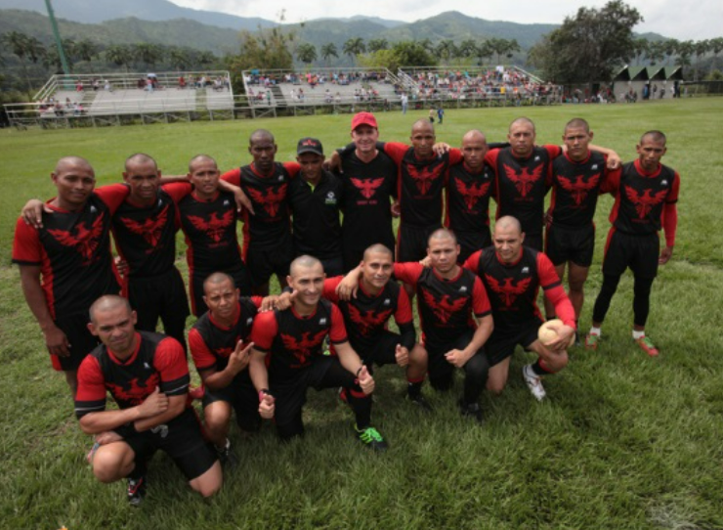
Proyecto Alcatraz
Penitentiary Rugby: using training in values, and through the constant and disciplined practice of rugby and psychoeducational support those deprived of liberty are reintegrated into society.

Slide 17
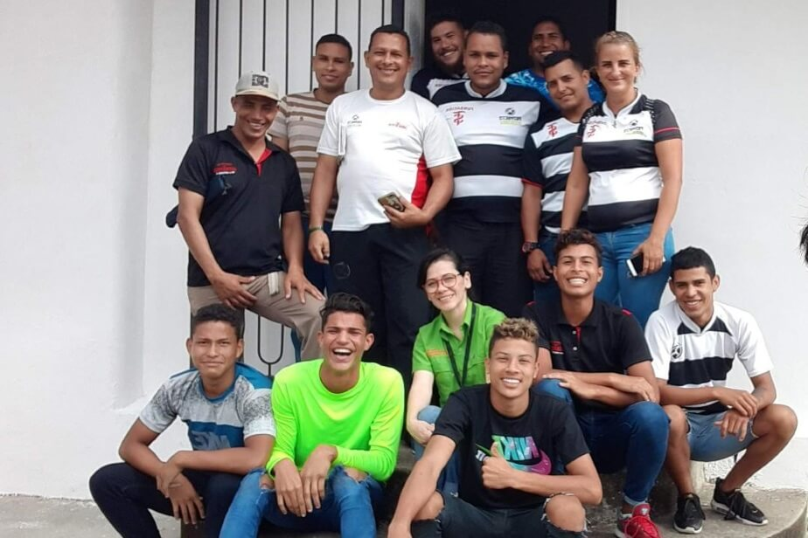
Proyecto Alcatraz
Prevention: through Alcatraz Rugby Club, composed of 5 categories: Infants, Under 14, Under 18, Female and Free Adults, they train kids and young adults on how to play rugby.
Consequently, they learn great ways to channel ‘violence’ in a good way since the sport has rules and by following them, fair play allows everyone to enjoy the game.

Slide 18
Proyecto Alcatraz
The environment where the kids grew up was so violent, that when given this opportunity to live in peace, without the fear of being killed, they would gladly take it, and not only that, but they would also invite friends to join.
By giving hope, sometimes we can save the lives of many by changing the lives of just a few, like the hope that was given to the kids that robbed the Hacienda Santa Teresa.
Personally, Proyecto Alcatraz made me realize how important it is to be given a chance for redemption, a chance to change the life you knew. And you?

Slide 19
Proyecto Alcatraz
The environment where the kids grew up was so violent, that when given this opportunity to live in peace, without the fear of being killed, they would gladly take it, and not only that, but they would also invite friends to join.
By giving hope, sometimes we can save the lives of many by changing the lives of just a few, like the hope that was given to the kids that robbed the Hacienda Santa Teresa.
Personally, Proyecto Alcatraz made me realize how important it is to be given a chance for redemption, a chance to change the life you knew. And you?

Slide 20
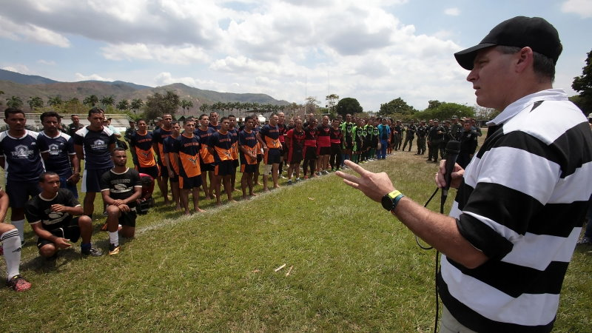
“Kids used to watch us playing with guns and they wanted to play with guns. Now they want to play with Rugby balls”
José Arrieta, Alcatraz R.C’s Trainer

